Slide 1
PyGame
We can finally make a game!

Slide 2
Today
What is Pygame? How does it work?
Using Pygame to create an interactive, graphical game

Slide 3
Pygame & Functions
Remind us what a function is?

Slide 4
Pygame & Functions
A function is a section of code that can be used many times while only being written once
A programmer can write their own functions, or use functions created by someone else
Functions are both convenient and efficient

Slide 5
Pygame & Functions
Pygame is a library that includes many new functions
These functions do not come standard with Python
You can download Pygame for free off the internet
The new functions included in Pygame are specifically meant to be used to make 2D games in Python

Slide 6
Testing Pygame
Open a Python window and type “import pygame”
Run the program
If you do not get an error just dance in your seat for a minute

Slide 7
On the following slides I will introduce you to the code that creates a graphical game
I will explain what the code does / why
It would be wise to listen to my descriptions, then write your own comments to remind yourself later of what the code does
Remember: this is meant to be referenced for your final project!

Slide 8
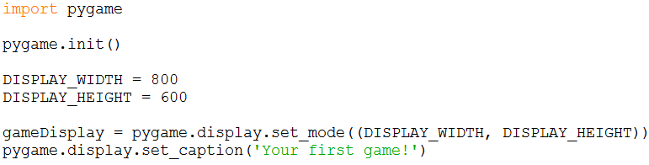
Step 1: Create an output window

Slide 9
Step 2: start the clock

Slide 10
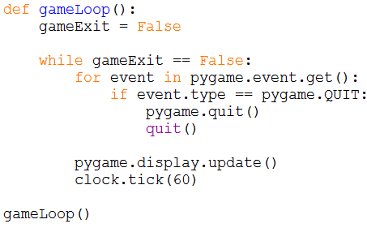
Step 3: establishing a game loop

Slide 11

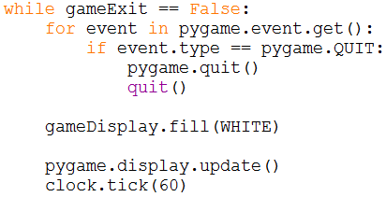
Step 4: make the background white

Slide 12
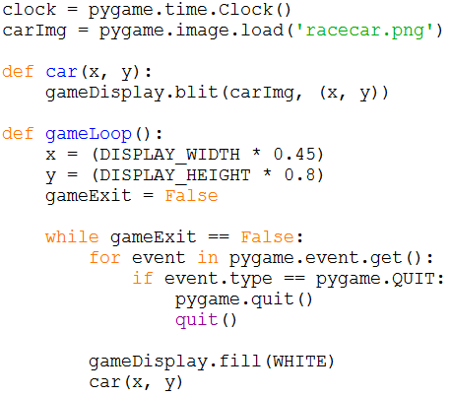
Step 5: display an image on the screen

Slide 13
Note
You can use an image of your chosen
You can find a “sprite” on the internet and download it
You MUST save it to the EXACT SAME FILE LOCATION as your python file
Give it a PROPER name because you need to type that name in to the python code
Can try here: https://opengameart.org/content/2d-complete-characters

Slide 14
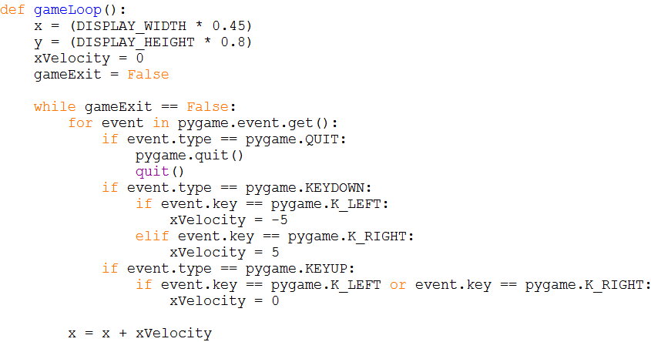
Step 6: make an image move on screen

Slide 15
If we want to:
Try to change the speed of the car
BONUS: try to move the car forward and backward

Slide 16
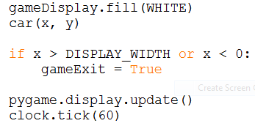
Step 7: Stopping car from leaving screen
Pay close attention when you test this one….

Slide 17
Step 7 (Cont.)
Imagine when you drive off the screen to the left the game correctly ends (as soon as any part of car touches edge)
When you drive off the screen to the right it lets you drive all the way off before it ends
Why did this happen?

Slide 18

A note on coordinates
The computer doesn’t see the image the same way we do
To the computer, the “location” of the image is a single pixel in the top – left corner
The code we wrote to stop the image from leaving the screen doesn’t seem to work on the right half of the screen because it only stops the game when the top-left pixel leaves the screen
By then the whole car is off the screen
On the LEFT side, the top-left pixel leaves the screen before most of the image does, so it looks like it works

Slide 19
Step 7 (Cont.)
So… what do we do to the if statement to make it work on both sides of the screen?

Slide 20

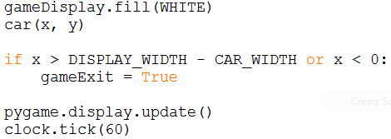
Step 7 (Cont.)

Slide 21
Step 8: Display message to screen
Note: can’t use a print() statement in pygame!
Graphical displays are very bad at displaying text
Get ready for some craziness….

Slide 22
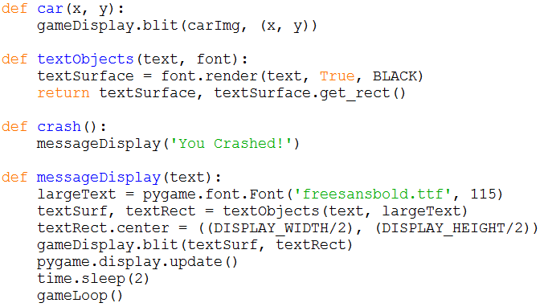
Step 8

Slide 23
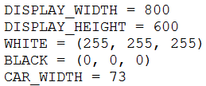

Step 8 (Cont.)

Slide 24
Step 8 (Cont.)
What happens when you test it and crash in to something?
Run time error!
import time at top of program because we’re using time.sleep(2)

Slide 25

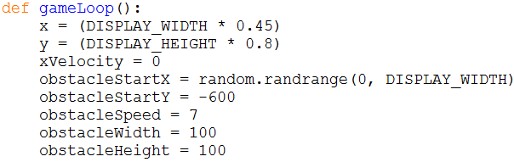
Step 9: Drawing simple images

Slide 26
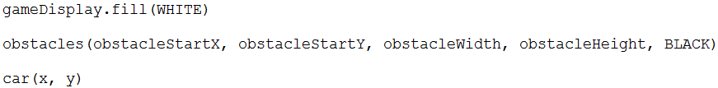
Step 9 (Cont.)
You’ll need to open the PP yourself to read these ones

Slide 27
Step 9 (Cont.)
The obstacles are “drawn” WAY above the visible screen
We haven’t told the computer to move the obstacles yet, so they never appear
How do you think we can do that?

Slide 28
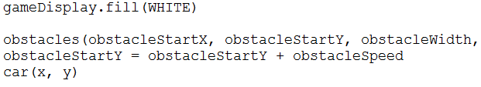
Step 9 (Cont.)

Slide 29
Step 9 (Cont.)
We only see one obstacle go by
We can do to make more appear

Slide 30
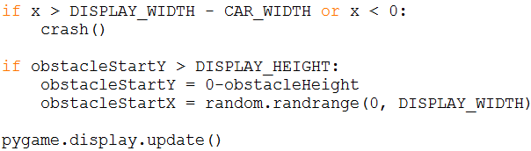
Step 9 (Cont.)

Slide 31
Step 10: Crashing into obstacles
It is possible for the car to actually crash in to these obstacles
In order to know if a crash has taken place, we need to know how to check if the car and obstacle are touching
This is called “collision detection”
We can check if the two have touched each other

Slide 32

Step 10 (Cont.)
The computer sees the current location of each image as one pixel at the top-left of the image

Slide 33
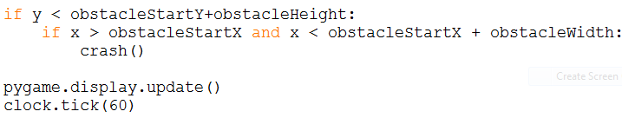
Step 10 (Cont.)

Slide 34
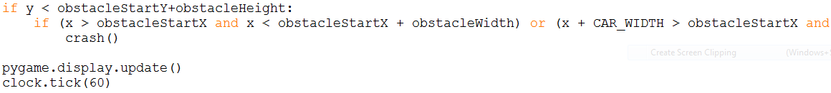
Step 10 (Cont.)
So long can’t fit it all on screen at once…

Slide 35
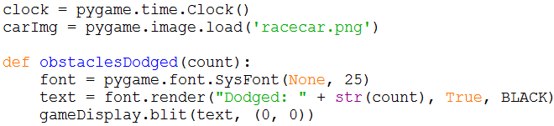
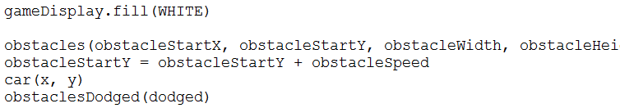
Step 11: Adding a score
We can change value of dodged

Slide 36

Step 11 (Cont.)
We need to declare dodged in the gameLoop() (at top of function with other variable declarations)

Slide 37
That’s it!
We now have a functioning game
For your reference:
https://pythonprogramming.net/pygame-python-3-part-1-intro/
This is a step-by-step guide explaining what we just did
It has written descriptions and videos
It also shows you how to do a lot more than we did
Note that we stopped at the “Pygame score” lesson

Slide 38
More Resources
Pygame Tutorial for Beginners
https://www.youtube.com/watch?v=FfWpgLFMI7w
Or
Pygame Tutorial #1 - Basic Movement and Key Presses
https://www.youtube.com/watch?v=i6xMBig-pP4
Pygame Tutorial #2 - Jumping and Boundaries
https://www.youtube.com/watch?v=2-DNswzCkqk
Pygame Tutorial #3 - Character Animation & Sprites
https://www.youtube.com/watch?v=UdsNBIzsmlI

